Slide 1




SAVEETHA SCHOOL OF ENGINEERING
SAVEETHA INSTITUTE OF MEDICAL AND TECHNICAL SCIENCES.
COURSE CODE: CSA1580
CLOUD COMPUTING FOR BIG DATA ANLYTICS FOR CLOUD API
Develop the Resource management based on elastic cloud a balancing and job
As cloud computing continues to transform the digital landscape, efficient resource management has become paramount. Addressing the dynamic demands of cloud environments requires a comprehensive approach that leverages advanced techniques like elastic cloud balancing and job shop scheduling.
Presented By:
Name: D. Avinash
Reg no: 192211736

Slide 2
Elastic Cloud Balancing: Adaptive Resource Allocation
Real-Time Monitoring
Intelligent Scaling
Cost Optimization
Continuously track resource utilization and workload patterns to identify optimization opportunities.
Dynamically provision or deprovision resources based on demand, ensuring optimal performance.
Reduce operational expenses by efficiently allocating resources and minimizing waste.

Slide 3
Job Shop Scheduling: Optimizing Task Execution
Task Prioritization
Workflow Optimization
Analyze the importance and dependencies of tasks to establish optimal execution order.
Identify and eliminate bottlenecks, streamlining the overall execution process.
1
2
3
Resource Allocation
Assign tasks to the most suitable resources, considering factors like availability and expertise.

Slide 4

Integrating Elastic Cloud Balancing and Job Shop Scheduling
1
Synergistic Approach
2
Improved Efficiency
3
Responsive to Change
Combine the dynamic resource allocation of elastic cloud balancing with the optimized task execution of job shop scheduling.
Achieve higher throughput, reduced latency, and increased resource utilization by leveraging the strengths of both techniques.
Adapt to fluctuating workloads and resource constraints, ensuring reliable and scalable cloud-based operations.

Slide 5
Resource Management Framework: Architecture and Components
Monitoring and Analytics
Intelligent Orchestration
Collect and analyze real-time data on resource utilization, workloads, and performance metrics.
Automate the provisioning, scaling, and optimization of resources based on dynamic needs.
Adaptive Scheduling
Optimization Engine
Prioritize and schedule tasks to maximize efficiency, considering resource availability and dependencies.
Continuously refine the resource management strategies using machine learning and predictive analytics.

Slide 6



Case Study: Implementing the Framework
Data Center Optimization
Scalable Media Streaming
Agile E-commerce Platform
Improved resource utilization and reduced operational costs in a large-scale data center.
Seamless scaling of a popular video streaming platform to handle peak traffic demands.
Enabled rapid scaling and load balancing for an online retail business during flash sales.

Slide 7
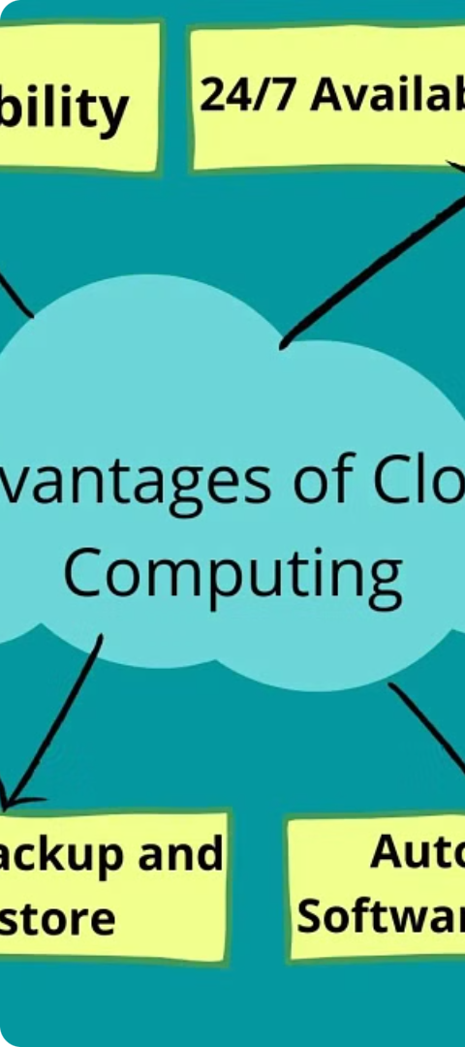



Benefits and Challenges
Improved Efficiency
Increased resource utilization and reduced operational costs.
Scalability and Responsiveness
Ability to quickly adapt to changing workloads and resource demands.
Complexity Management
Coordinating the integration of various components and technologies.

Slide 8
Future Directions and Potential Applications
Predictive Analytics
Leverage machine learning to anticipate resource needs and optimize proactively.
Edge Computing
Extend the resource management framework to distributed edge environments.
Containerization
Integrate with containerization technologies for improved portability and isolation.
Blockchain Integration
Explore the use of blockchain for secure and transparent resource allocation.

Slide 9
Conclusion
The convergence of elastic cloud balancing and job shop scheduling represents a powerful strategy for comprehensive resource management. It leverages the strengths of both methodologies to create a robust system capable of handling the dynamic nature of modern workloads and production demands. This integration not only optimizes resource utilization but also drives cost-efficiency and improves overall performance, making it an invaluable approach in both cloud computing and manufacturing industries.
Elastic cloud balancing allows for dynamic scaling of resources based on real-time demand. This ensures that resources are allocated efficiently, avoiding both over-provisioning and under-provisioning. By adjusting resource usage in response to workload changes, elastic cloud balancing helps in reducing operational costs. Resources are only utilized when necessary, leading to significant cost savings. Improved Performance: Automatic distribution of workloads across multiple servers ensures high availability and reliability. This leads to better performance and user experience. Elastic cloud balancing supports a variety of workloads and can adapt to sudden changes in demand, making it suitable for diverse applications and industries.
Resource management is a critical aspect of cloud computing and manufacturing processes, particularly when optimizing performance and cost-efficiency. Two prominent techniques in this area are elastic cloud balancing and job shop scheduling. Let's conclude how these techniques can enhance resource management.

